Slide 1
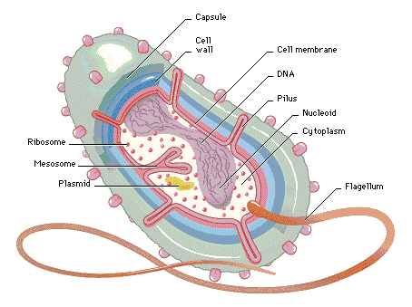
Microbial identification by
MALDI-TOF/Saramis
Research Center for Genetic Engineering and Biotechnology “Georgi D. Efremov”, MASA
What is MALDI-TOF/Saramis?
The MALDI-TOF/SARAMIS™ is an ideal and sophisticating tool for microorganism identification like bacteria, yeast, fungi, and spores. SARAMISTM is a software and database tool for the rapid automated identification of microorganisms on the basis of their characteristic MALDI-TOF (Matrix Assisted Laser Desorption Ionization-Time-of-Flight) fingerprint mass spectra. The SARAMIS™ database contains spectra of human and veterinary pathogens, food pathogens and environmental microorganisms. Every strain produces a MALDI-TOF mass fingerprint pattern with specific signals at strain, species, genera and family level. These specific signals can be used as mass patterns for automated identification of unknown strains.
SARAMIS database
The SARAMIS™ microorganism identification is done by so called SuperSpectra™. The SuperSpectra™ are generated based on measurements of well known microorganisms and contain sets of genus, species and strain biomarkers which are characteristic for the respective group of microorganisms.
The first SARAMIS™ database included spectra of more than 2.000 species and 500 genera. Since the beginning in 1999, more than 2.800 Super Spectra for microorganism identification are available today. The list of the microorganisms that can be identified using SARAMIS is available at http://www.anagnostec.eu/products-services/reference-databases.html. Extensions of the database are carried out regularly.
Analysis method performed at RCGEB
The analysis at RCGEB starts with selection of a single cell colony (or small amount of cells if grown on liquid media) and transfer to the MALDI target. The cells are transferred directly on the target and immobilised with addition of 1 µl matrix (40 mg/ml α-Cyano-4-hydroxycinnamic acid (CHCA) in water/acetonitrile/ethanol (1:1:1) with 0.03% trifluoroacetic acid. The mass spectra is obtained using linear mode of the MALDI-TOF-TOF mass spectrometer with data acquisition range from m/z = 2.000 to 20.000. After smoothing, baseline correction and peak detection steps peak lists are transferred directly to the SARAMIS software. In SARAMIS software the pattern is analyzed with comparison function against the SARAMIS database and the unknown isolate is identified.
Advantages over conventional methods
The microbial identification by MALDI-TOF/SARAMIS offers significant advantages over conventional microbiological (morphological, immunological, biochemical) and molecular identification (PCR, sequencing). This method is simple, fast, high-throughput and offers:
Safe and reliable identification down to species level
Identical processing of all microorganisms
Applicable for all microorganisms grown on agar plates
Takes only 2 min from colony picking to result or up to one hundred individual measurements or identifications per hour.
The detection limit for the MALDI-TOF MS analysis was determined to be below 100 cells.
Material for testing
The bacteria, yeast and fungi can be grown on standard agar plates. All standard media can be used for growing the microorganisms. The incubation times from 16-48 h is preferable for analysis.
Microbial identification by MALDI-TOF/Saramis at RCGEB | Price (МКД)
Identification of 1 strain | 700
Literature:
Claydon MA, Davey SN, Edwards-Jones V, Gordon DB. (1996) The rapid identification of intact microorganisms using mass spectrometry. Nat Biotechnol 14: 1584–1586
Giebel R, Worden C, Rust SM, Kleinheinz GT, Robbins M, Sandrin TR. (2010) Microbial fingerprinting using matrix-assisted laser desorption ionization time-of-flight mass spectrometry (MALDI-TOF MS) applications and challenges. Adv Appl Microbiol. 71:149-84.

Slide 2
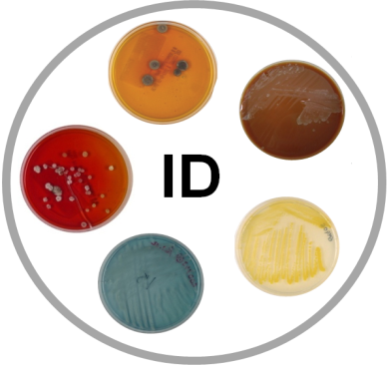
Microbial identification by
MALDI-TOF/Saramis
Research Center for Genetic Engineering and Biotechnology “Georgi D. Efremov”, MASA
What is MALDI-TOF/Saramis?
The MALDI-TOF/SARAMIS™ is an ideal and sophisticating tool for microorganism identification like bacteria, yeast, fungi, and spores. SARAMISTM is a software and database tool for the rapid automated identification of microorganisms on the basis of their characteristic MALDI-TOF (Matrix Assisted Laser Desorption Ionization-Time-of-Flight) fingerprint mass spectra. The SARAMIS™ database contains spectra of human and veterinary pathogens, food pathogens and environmental microorganisms. Every strain produces a MALDI-TOF mass fingerprint pattern with specific signals at strain, species, genera and family level. These specific signals can be used as mass patterns for automated identification of unknown strains.
SARAMIS database
The SARAMIS™ microorganism identification is done by so called SuperSpectra™. The SuperSpectra™ are generated based on measurements of well known microorganisms and contain sets of genus, species and strain biomarkers which are characteristic for the respective group of microorganisms.
The first SARAMIS™ database included spectra of more than 2.000 species and 500 genera. Since the beginning in 1999, more than 2.800 Super Spectra for microorganism identification are available today. The list of the microorganisms that can be identified using SARAMIS is available at http://www.anagnostec.eu/products-services/reference-databases.html. Extensions of the database are carried out regularly.
Analysis method performed at RCGEB
The analysis at RCGEB starts with selection of a single cell colony (or small amount of cells if grown on liquid media) and transfer to the MALDI target. The cells are transferred directly on the target and immobilised with addition of 1 µl matrix (40 mg/ml α-Cyano-4-hydroxycinnamic acid (CHCA) in water/acetonitrile/ethanol (1:1:1) with 0.03% trifluoroacetic acid. The mass spectra is obtained using linear mode of the MALDI-TOF-TOF mass spectrometer with data acquisition range from m/z = 2.000 to 20.000. After smoothing, baseline correction and peak detection steps peak lists are transferred directly to the SARAMIS software. In SARAMIS software the pattern is analyzed with comparison function against the SARAMIS database and the unknown isolate is identified.
Advantages over conventional methods
The microbial identification by MALDI-TOF/SARAMIS offers significant advantages over conventional microbiological (morphological, immunological, biochemical) and molecular identification (PCR, sequencing). This method is simple, fast, high-throughput and offers:
Safe and reliable identification down to species level
Identical processing of all microorganisms
Applicable for all microorganisms grown on agar plates
Takes only 2 min from colony picking to result or up to one hundred individual measurements or identifications per hour.
The detection limit for the MALDI-TOF MS analysis was determined to be below 100 cells.
Material for testing
The bacteria, yeast and fungi can be grown on standard agar plates. All standard media can be used for growing the microorganisms. The incubation times from 16-48 h is preferable for analysis.
Microbial identification by MALDI-TOF/Saramis at RCGEB | Price (МКД)
Identification of 1 strain | 700
Literature:
Claydon MA, Davey SN, Edwards-Jones V, Gordon DB. (1996) The rapid identification of intact microorganisms using mass spectrometry. Nat Biotechnol 14: 1584–1586
Giebel R, Worden C, Rust SM, Kleinheinz GT, Robbins M, Sandrin TR. (2010) Microbial fingerprinting using matrix-assisted laser desorption ionization time-of-flight mass spectrometry (MALDI-TOF MS) applications and challenges. Adv Appl Microbiol. 71:149-84.

